Slide 1
Opportunity for agents within the Renters’ Rights Bill
Presented By: Susie Crolla BA Hons LLB MPhil

Slide 2
Agenda
The Renters’ Rights Bill is the biggest shakeup in lettings legislation for a generation..
With change comes opportunity for those eager to embrace it.
We explore strategies to increase value to clients, strengthen services for landlords, and stay ahead of the competition.
• Understand landlord concerns and needs • Identify key opportunities for letting agents • Explore tools to support landlords

Slide 3
What next for the Bill?
01
02
03
04
Report Stage
3rd Reading
Limited Window
before Recess
22 July – Early September 2025
October–November 2025
Three days of debate scheduled. Amendments under discussion.
Seven days between the final Lords debate and the Commons summer recess.
Possible
commencement
date
Parliamentary Recess
Parliament is not sitting. No legislative expected.

Slide 4
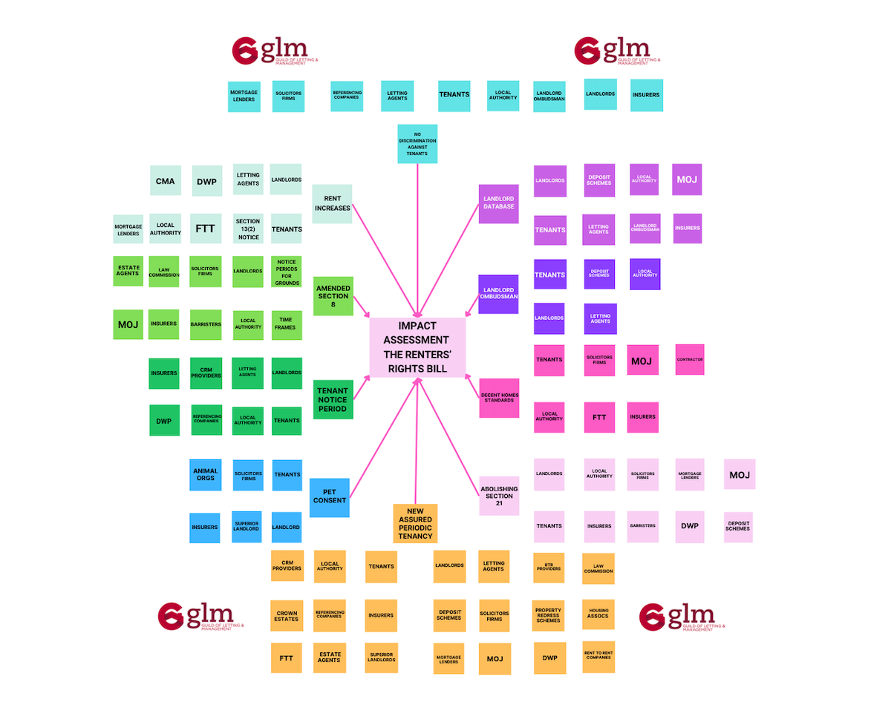
The infographic illustrates the impact of the change in Legislation on many different areas.
It demonstrates the ‘work’ that MUST be done to be compliant ready.

Slide 5
Process
WORK BACKWARDS FROM IMPLEMENTATION DATE TO DEVISE ACTION PLAN
01
REQUEST TIME FRAMES FROM YOUR SUPPLIER RE; UPDATES, DOCUMENTS, REFERENCING
04
02
PUT IN PLACE INTERNAL CHECK LIST TO ENSURE PORTFOLIO IS COMPLIANT READY
05
UPDATE & TRAIN YOUR TEAM
DISCUSS CHANGES TO WORKFLOWS WITH CRM PROVIDER
03
UPDATE LANDLORDS & TENANTS
06

Slide 6
The Landlords
Corporate Entities (Companies)
Crown Estates
The Church
Commercial Entities (Not residential)
Pension Funds
Private Individuals
Limited Companies (Many landlords have put their properties into Limited Companies for tax purposes)
Charities
Trusts
Local Authorities
Housing Associations
Landowners

Slide 7
Work in partnership with your landlords
In challenging times landlords need to be reassured.
YOU will be their comfort blanket.
If you have not done so already, communicate openly with the landlord about what they WILL be required to do to be COMPLIANT READY.
7

Slide 8
Your service
IS
invaluable

Slide 9
The landlord needs to be reminded of the benefits of using an agent to manage their properties far outweighs the fee the agent charges.
Ask yourselves the following:-
Do landlords understand what you will do for them?
Do landlords understand what their obligations will be?
Do landlords understand using an excellent letting agent protects them, their investment and their tenant?
Are landlords aware that the fee paid to their letting agent, the fees for the Private Rented Sector Database registration & for Landlord Ombudsman can be off-set against their tax return?
Does the landlord have the systems and processes you have in place are invaluable?
Using YOUR services V an RRO - well there is no competition!

Slide 10
Terms & conditions of buisness
To comply with the Renters' Rights Bill, letting agents should update their Ts & Cs to reflect the new legal requirements.
Removal of Fixed-Term Clauses:
Include Actual Authority
Fee structure to be reviewed
Update terms to remove references to fixed-term agreements since all tenancies will be periodic by default.
(Include an Assignment Clause)
This will give you the authority to upload data on the Private Rented Database on the landlord’s behalf.
TFO / Intro Only Landlords will require more time & work
Service of Section 8 will be more complex
Pre-rent increase process must be carefully executed to avoid challenges from tenants

Slide 11
Value Added Opportunities
1. Termination of Tenancy - Clarify the circumstances under which the agent or Landlord can terminate the management agreement, reflecting the abolition of Section 21 and service of Section 8 Notice. How involved will you be? Will you complete & serve the Notice? Will this be included in your management fee? 2. Rent Reviews – The process will be invaluable to landlords. The tenant has the right to challenge the rent increase, so a well executed process will be invaluable. How involved will you be? Will you complete & serve the Notice? Will this be included in your management fee? Will you deal with the response to the FTT if the tenant challenges the rent increase?

Slide 12
Value Added Opportunities
3. Key documents / letters / forms for specific reasons :-
Pet Profile for pet owners requesting consent for a pet
Rent review documents
Service of Section 8 & additional correspondence
Housing Condition Report
4. Manage and implement COMPLIANCE service – The Private Rented Sector Database will require all landlords to be compliant.
Failure to do so will exclude landlords from LAWFULLY renting their properties & prevet them from obtaining possession.
Service levels & fees will differ for TFO Landlords and Fully Managed Landlords

Slide 13
Value Added Opportunities
5. Minimising Risk -Landlords will require comprehensive insurance cover
Letting agents who incorporate insurance solutions into their core services stand to:-
Strengthen client relationships.
Create multiple, scalable income streams.
Reduce risk for both landlords and themselves.
Enhance their professional reputation as compliance-driven property professionals
Insurance Product
Rent Guarantee Insurance
Legal Expenses Insurance
Landlord Buildings Insurance
Tenant Liability Insurance
Pet Damage Insurance *

Slide 14
thank you…
Susie Crolla BA Hons LLB MPhil

